Slide 1
Inventions of the Renaissance

Slide 2
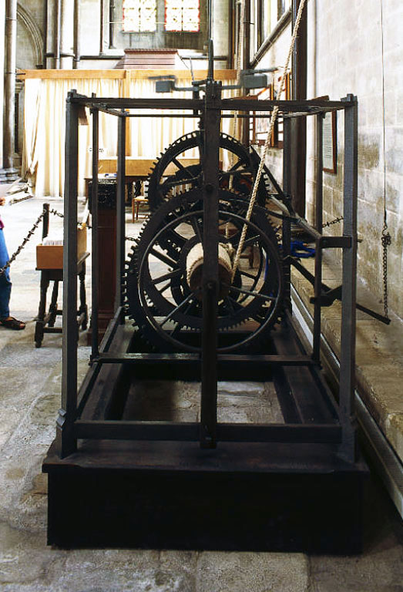
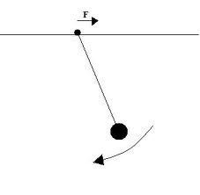
The Clock
The first mechanical clock was invented in the early 1300's. With this invention, time began to be measured in hours.
Galileo, an Italian scientist, discovered the pendulum in 1581. The pendulum greatly improved the constant movement of the hands or bell of a clock. The average error with the pendulum varied only by seconds each day. Before this the error was from 10 to 15 minutes a day.
Pendulum →

Slide 3
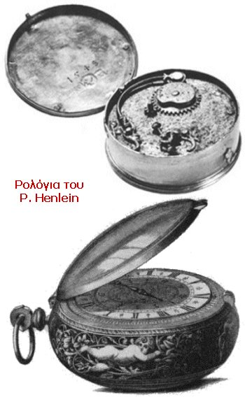
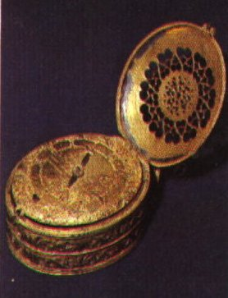
The Watch
The portable watch was invented by German Peter Henlein in 1505. He created his watch to be spring powered making it much smaller.
This watch was a pocket watch. The wrist watch didn’t come into widespread use until the 1800’s

Slide 4
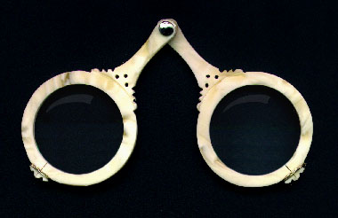
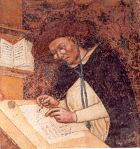
The Eyeglasses
Historians are not certain who invented the first spectacles or eyeglasses. In the late thirteen century around 1287 paintings first appeared with people wearing or holding spectacles. From these paintings we know that spectacles were invented in Italy.
In 1352 eyeglasses were only worn by the well educated, very rich noblemen or well read Italian clergy.
Due to the invention of the printing press many people began buying books. Once people owned books reading glasses began to be seen in the hands of the common people.

Slide 5
The Printing Press
The printing press was invented in 1436 by a German named Johannes Gutenberg. Before the printing press was invented, monks had to copy everything by hand. Hand written books took months or years to hand print. This made books very expensive.
Since ink, movable type, paper, and the press had been invented. Gutenberg creatively combined these inventions to devise the printing press.
Gutenberg used the printing press to put ink on hundreds of individual letters. These letters were engraved in slabs of brass. These letters were arranged in words, sentences, then paragraphs. After this stage as many copies as needed could be made quickly. When a different page was need the individual letters had to be completely rearranged.
The Bible was the first book to be mass produced. The Gutenberg Bible was also known as the 42 line Bible from the number of lines on each page. It was published in 1456 in Mainz, Germany.

Slide 6
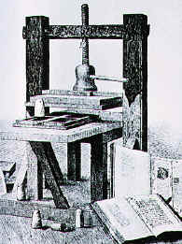
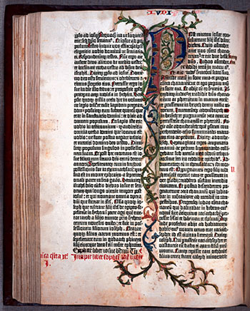
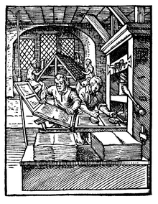
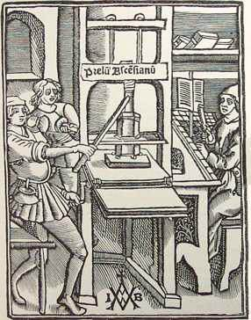
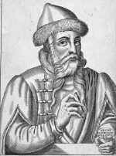
The Gutenberg Bible
Johannes Gutenberg

Slide 7
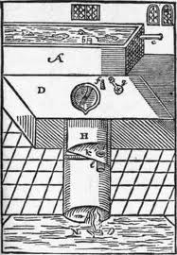
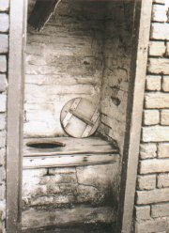
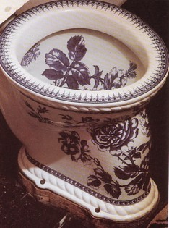
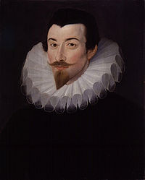
The Water Closet
Sir John Harrington, godson to Queen Elizabeth, made the first flush toilet for himself and his godmother in 1596. He was teased by his friends and never made another one although he and Queen Elizabeth continued to use the one he did make.
Harington invented a valve that when pulled would release water from a water closet.
Two hundred years later Alexander Cummings reinvented the flush toilet more commonly called the water closet.

Slide 8
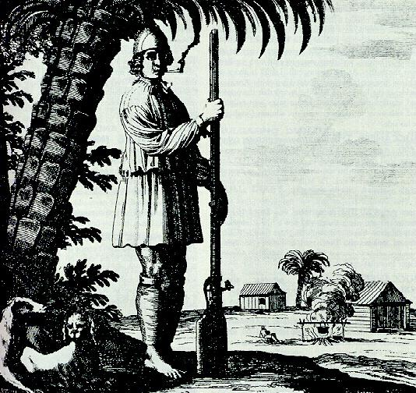
Gunpowder in Europe and the Musket
Gunpowder was invented around 850 A.D. The Chinese used gunpowder in the early 1230's to launch fireworks and in weapons.
Gunpowder was probably used for the first time in Europe during the Battle of Crécy in 1346. Historians do not know if this invention was carried from China to Europe or in The Europeans invented it independently.
The musket was the first usable rifle that soldiers could carry into battle.
It was developed in Spain in the 1500’s.
It could fire a metal ball that could seriously kill or hurt someone.
The first muskets were very large weighing 40 pounds and being over 6 feet long.

Slide 9
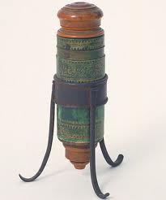
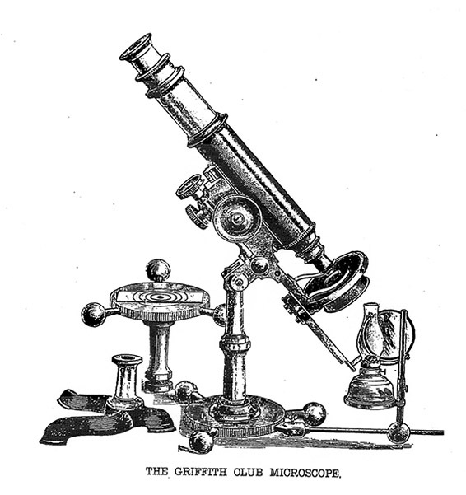
The Microscope
The first useful microscope was developed in the Netherlands between 1590 and 1608. Three different eyeglass makers are given credit for this invention.
Galileo helped popularize the microscope in the early 17th century.

Slide 10
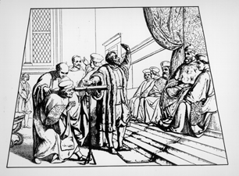
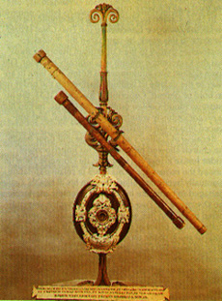
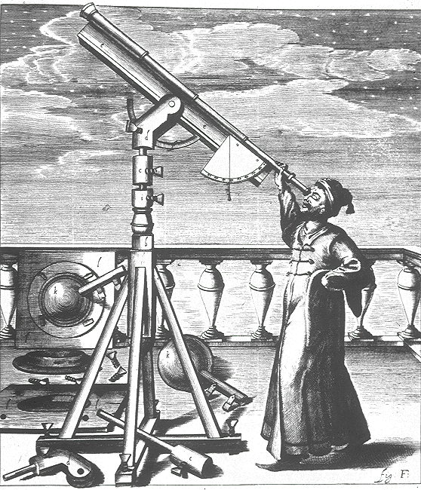
The Telescope
Using the idea of the microscope to guide him, Hans Lippershy decided to invent the telescope in 1608. Lippershy thought that if a microscope could enlarge images too small for the naked eye to see, there must be a way to enlarge objects too distant for which to get a good view. He accomplished this by combining two lenses and a tube in a different way than previously used in the microscope.
Galileo Galilei used the telescope to develop his theories and ideas about Earth and its relation to the stars and the rest of the universe.

Slide 11
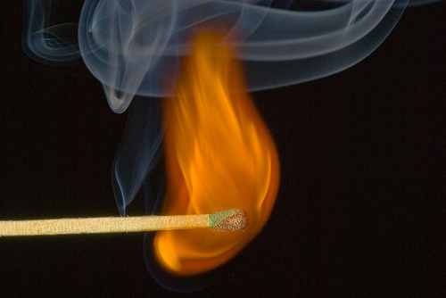
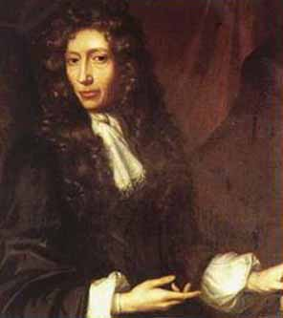
The Match
Fire - our worst enemy, our best friend - was difficult to create until Robert Boyle invented the match in 1680. Although fire could be made by rubbing sticks together or by striking flint to steel, this was a time consuming process. Boyle discovered that when phosphorus and sulfur were rubbed together, they would burst into flame. Boyle knew that this was not because of friction, but because of chemical nature of these two substances. Although convenient, Boyle's matches were not very safe, because sometimes they accidentally went up in flames while in a pocket. (Warm surprise!)

Slide 12
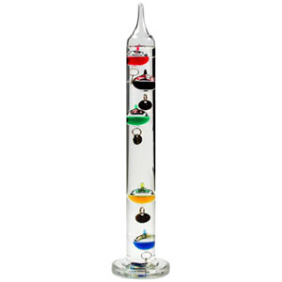
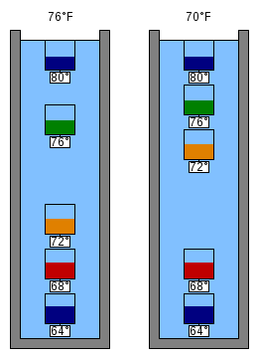
The Thermometer
The Thermometer was invented by Galileo in 1593 which, for the first time, allowed temperature variations to be measured. In 1714, Gabriel Fahrenheit invented the first mercury thermometer, the modern thermometer.
Thermometers measure temperature, by using materials that change in some way when they are heated or cooled.

Slide 13
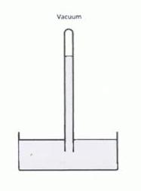
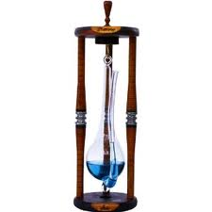
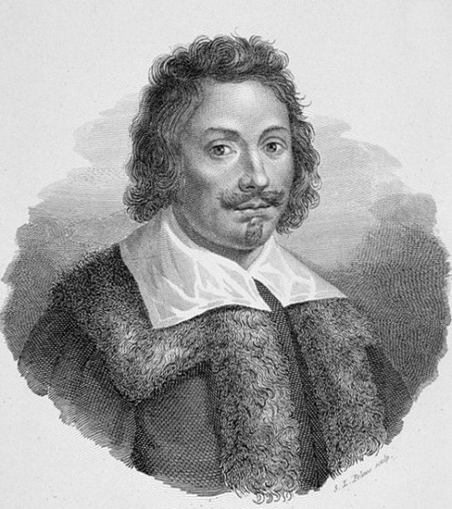
The Barometer
The first mercury barometer was invented in Italy in 1643 by Evangelista Torricelli. While being taught by Galileo, Torricelli conducted experiments concerning vacuums. He experimented with mercury in a tube placed inside a dish. He soon discovered that atmospheric changes caused the mercury level to rise and fall within the tube. He continued to fine-tune the invention until he produced a reliable barometer that could measure the barometric pressure.
Today we use the barometer to predict weather changes.

