Slide 1
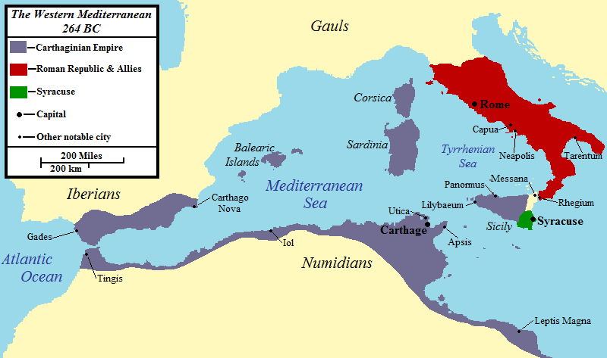
The 2nd Punic War

Slide 2
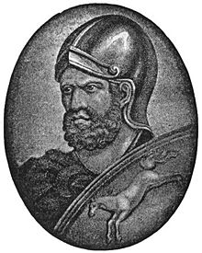
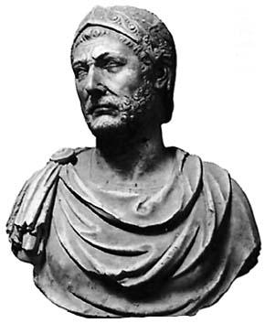
Intro to the 2nd Punic War
Hello Hannibal!
You are quite the spontaneous young man, aren't you? The Carthaginian Senate is extremely nervous about having you in Spain (what the Romans call Iberia), since they fear that it will cause two major problems.
First, they fear that folks will come to assume that you took command of te Carthaginian forces since your father was a general, which might lead to you becoming a king that would completely change the Carthaginian way of life. The military is always a threat to the political stability of a nation, because it is the only power able to take control of the country. The Senate does not wish you to become so popular and so powerful that you might try to take control of all Carthage.
The second threat in all this is that you may provoke war with Rome. If this happens, it will be assumed that you have done so in order to advance your own political aspirations. The Senate firmly believes that even an uneasy peace with Rome is preferable to what would surely be a devastating war between the two cities.

Slide 3
Scenario #1
Arriving on the scene, you are faced with your first major choice. You no doubt wish to prove to the men of the army that you are indeed your father's son, deserving of the same respect they gave him. How to go about this is, of course, debatable. What will you do?
Option 1: Step right into his vacated position, and show the men what you can do. As the son of the supreme general, you could move into his big tent, dress in his fine clothes, and start issuing commands. By impressing the men with your ability to take command of a situation, you could show them that you have inherited your father's ability to make decisions quickly.
Option 2: Your other choice is to take a more quiet approach. You could insist on working at hard labor, living an average military life, and sleeping under the stars on the ground, where your men do. It would be a lot different than the luxury and comfort of Carthage, and rather unusual for a man of your position.
Now, you must choose. What will you do?
Option 1 Step into your father's position
Option 2 Act like every other soldier

Slide 4
Option 1 : Stepping into your fathers position
You have changed history!
By attempting to step directly into your father's position, you have accomplished a number of things.
You have offended your commanding officer, Hasdrubal, who has the right to command, being your father's second in command.
You have offended the men in your command, because you have not yet earned their respect, and they cannot be certain whether they should trust you.
By offending your countrymen, you have given hope to your enemies, who are always aware of conditions in your camp, due to the comings and goings of traders and spies.
Remember in your future choices that Hannibal is clever and sly, and seldom errs in his judgment. He will inevitably make the choice that will earn him respect from his men, and cause his enemies to despair. Scroll down to see the historically correct choice.
Go to the Correct Answer!

Slide 5
Option 2: Act like every other solider
Excellent choice!
The "real" Hannibal was respected by his men for attending to his duties with energy, patience, and honor. He dressed plainly, did not treat himself in luxuries, and never expected to be excused from the jobs of a normal soldier. By doing so, his men saw him as a friend and equal, which left them free to admire his energy, capability, and skill. It was said that he was the first into battle, and the last to leave the field, earning him respect for bravery and fighting ability. He was considered merciless to his enemies (which the Carthaginian soldier admired) and very intelligent in his strategies and tactics. These behaviors put him in excellent position when the army needed a new leader, because he had not only the name of a leader, but the qualities of one, as well.
Now is your next decision!!

Slide 6
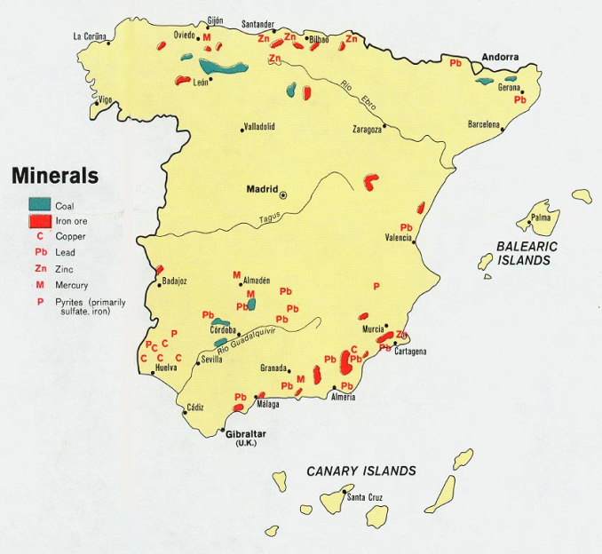
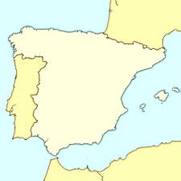
Scenario #2
Hasdrubal's the 2nd in command died, leaving the army temporarily leaderless, but Hannibal was chosen by his men as the leader.
While expanding the Carthaginian empire, Hannibal finds himself in an area with a Roman force some 5 times larger than his own. They pursue him to the banks of the River Tagus, which is approximately 3 feet deep at this location. He could choose to stand and fight, using the river at his back as motivation to his men to fight boldly. If his soldiers prove superior, the Romans will be unable to outflank him. If the Romans prove to be overwhelming, he may still be able to withdraw his army across the river, though it will probably cost many men to do so.
Either way, he is anxious to engage Roman forces soon, so that he can prove his ability.
Option 1 Stand and Fight
Option 2 Cross the River and Fight Elsewhere Spain

Slide 7
Option 1: Stand and Fight
You have changed History!
It is considered bad policy in this era to use rivers at your back, since retreating would be slow work that could cost you many of your troops. Had Hannibal chosen to stand here, he'd probably have had his army (and himself) slaughtered.
Go to the Correct Answer!

Slide 8
Option 2: Cross the River and Fight Elsewhere
Good decision!
Hannibal realized that he could only defeat such a large force by using his wits, and this was the perfect opportunity. He hurried his army across the river, hiding his cavalry (soldiers on horses).
The Romans, excited to give the young commander an early defeat, pursued him at top speed. This led to their undoing, as it is extremely difficult to fight in 3 feet of water! While the Roman force was up to its armpits in river, the Carthaginian cavalry rushed in with them. The horsemen of the cavalry, free to swing swords and thrust spears, destroyed the Roman force. Once the Romans retreated, Hannibal's army raced back across the river, and thumped 'em good.
Now, you will have another choice.

Slide 9
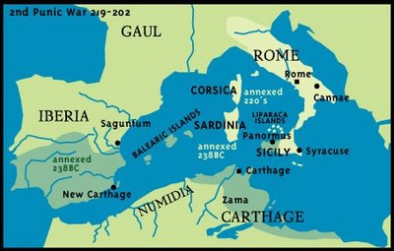
Scenario # 3
Fresh off his victory, Hannibal was even more excited to attack his sworn enemy.
Saguntum was the southernmost city in Spain, allied with Rome, it was a wealthy and well fortified city.
If Hannibal chooses to attack Saguntum, it will definitely start a Second Punic War, and all hopes of peace will be gone. Hannibal is not really in need of the money that rests in Saguntum, but it may not be wise to leave such a hostile city behind him, if he heads on to attack Rome itself. Attacking Saguntum will warn the Romans of Hannibal's intentions. It will also cause what we will call the Fortification Problem. It takes time and troops to reduce such a city, during which time the Romans may try to reinforce the town, or find other methods of resistance. Hannibal has neither unlimited time, nor the unlimited resources, that reducing cities requires.
Faced with these options, what would you do?
Option 1 Reduce Saguntum by force.
Option 2 Pass Saguntum by.

Slide 10
Option 1: Reduce Saguntum by force
You made the right choice to capture Saguntum before moving on.
Ironically, Hannibal almost lost his life here, when a javelin, thrown down from the city wall, rammed through his leg. He survived quite nicely, and the destruction of Saguntum was assured. The Saguntines hated Hannibal so much that they burned and melted their precious objects so that he could not use them, and then threw themselves into the fire, rather than become his mercenaries (soldiers for hire) or slaves.
At home, this victory caused his popularity to grow also, as he was elected suffete (pronounced, according to Durant, as "show-feet"). Suffete was similar to being consul in Rome, and gave Hannibal free rein to carry forth his war against Rome. This position virtually guaranteed that he would get the support he needed to bring his plans to fruition.
Here is his next choice.

Slide 11
Option 2: Pass Saguntum by
You have changed History!
Bypassing Saguntum would be a major mistake, because the inhabitants truly despise you, and would do everything they could to disrupt your further progress. You are already far from home, with stretched supply lines. You can’t afford to leave a fortified city, standing to the rear of your advance.
Go to the Correct Answer!

Slide 12
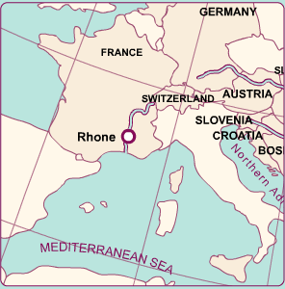
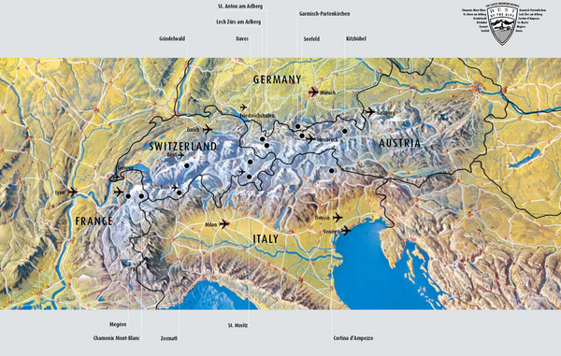
Scenario #4
At the Rhone River, Hannibal's cavalry found itself near the Roman army. Hannibal now knows that the Romans are at the mouth of the Rhone, in great numbers. His original plan was to continue on to cross the Alps, and descend upon Rome from the north. To travel south and fight the Romans now may mean that Hannibal could destroy their army in one major battle, and therefore leave Rome crippled for the rest of his assault. He would also need to defeat the navy. Even if he were successful in this, he would face what we will call the Port Problem. The geography of Italy is such that there are very few good harbors in which he could land, and these might be fortified against him.
What choice would you make?
xxxxx
GAUL
Option 1 Cross the Alps.
Option 2 Go down the Rhone.

Slide 13
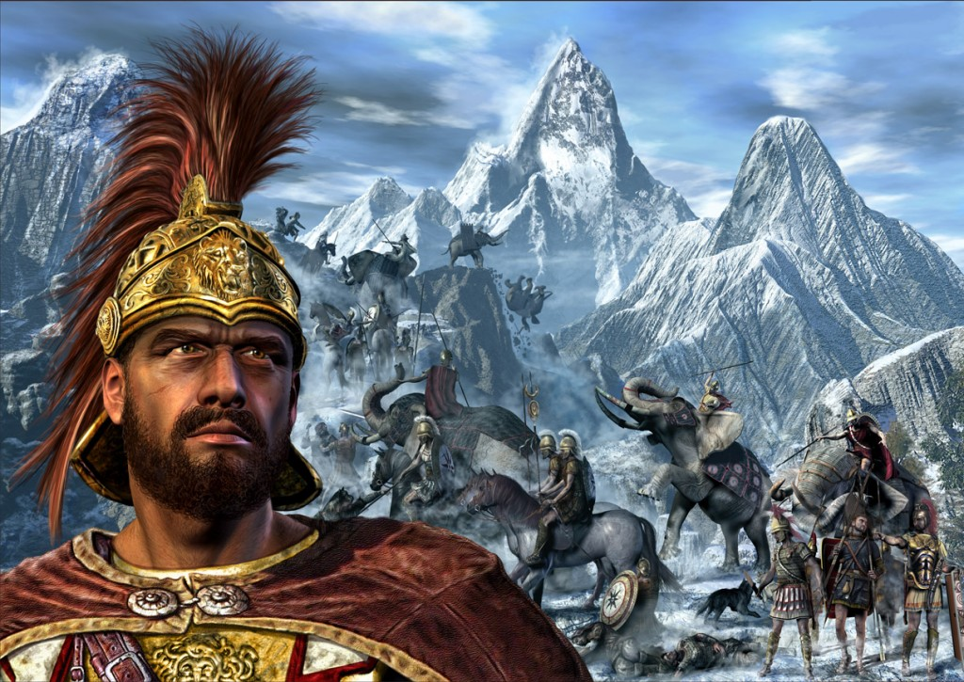
Option 1 Cross the Alps
Though he had to do some fast talking to inspire his men, Hannibal convinced them that the best course was to stay on track and cross the Alps. Still, it was no easy journey. Many mountain men lived in the Alps, and they resisted Hannibal's advance by throwing rocks down upon his men from ledges above. Often the snow and ice gave way underfoot, and men plummeted to their deaths. Most difficult of his equipment to move were the elephants, and Hannibal lost most of these to the narrow paths, or the cold.
Soon, he would have another choice to make.
Go To your next Decision!

Slide 14
Option 2 Go down the Rhone
You have changed History!
Hannibal knew it was inevitable that he would have to invade Rome by land. Gambling that he could both destroy the Roman army, and take their navy would have been foolish. Then, not being able to invade Italy with that navy would have made the entire undertaking worthless. Hannibal had very little chance to gain the decisive victory he needed.
Go to the Correct Answer!

Slide 15
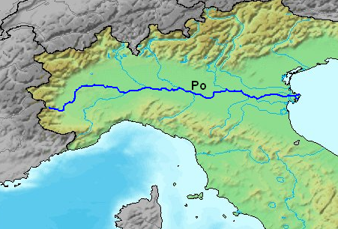
Scenario #5
Hannibal inspired his men by reminding them that they were now all veteran soldiers, whereas their opponents would be largely composed of new recruits. Hannibal's personality often caused his army to achieve feats seemingly beyond their ability. Here, he emphasized their team spirit, the great treasure in Rome, and that recrossing the Alps would be impossible. He brought in prisoners, and had them fight each other to the death, promising the winner a free pass home. This provoked his soldiers into a fighting frenzy.
At this point, the consul in charge of the Roman army that had been sent north was named Scipio. (The other consul, Sempronius, was sent south, to work his way to Africa, where he might attack Carthage itself.) Scipio was building a bridge across the Po river, when word came from scouts that Hannibal and his men were only 5 miles away. Hannibal was fully aware of Scipio's presence, but debated his best course of action. He could attack now, wading across the river to meet the Romans, or he could wait, letting them finish their bridge and come to his side. His men were still somewhat tired from their trip over the Alps, and in hostile territory. Quick action, though, might prevent the Romans from bringing the full might of their army upon him. Which would you choose to do?
Option 1 Attack the Romans now.
Option 2 Wait until the bridge is built.

Slide 16
Option 1: Attack the Romans now
You have changed History!
Had Hannibal crossed the Po River, he would probably have had to move north first, since he could not risk being caught by Scipio while crossing. Many areas in the Po region are swampy. It is difficult to fight while in water, and Hannibal certainly didn't want any disadvantages. Had he got his entire army across, it is equally possible that he may have destroyed Scipio's army, or that they may have been able to resist him.
Go to the Correct Answer!

Slide 17
Option 2: Wait until the bridge is built
By allowing Scipio to complete his bridge, you improve the likelihood of an engagement, and that is, after all, just what Hannibal wants. He made promises every day to his men that they would have great wealth once Rome was defeated.
The Romans crossed over, and went looking for Hannibal, with the two armies coming together at a point where neither was actually prepared to see the other. This sort of battle favored Hannibal and his veteran troops, who quickly formed up and attacked, while the Romans seemed unprepared by the whole encounter.
The destruction was terrible, Scipio was wounded, and the Roman army fled in retreat.
He was now faced with another decision.

Slide 18
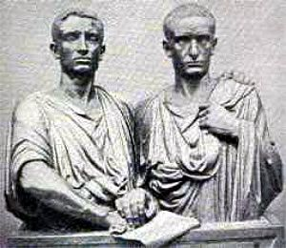
Scenario #6
The wounding of Scipio put the Roman army in dread of complete collapse. The Senate decided to bring Sempronius north from Africa, and have him reinforce Scipio's troops.
Here the Leadership Factor hit with full force, as the two consuls disagreed upon the best course of action. Scipio wished to delay until he was returned to full health while Sempronius wanted to attack. Scipio also knew that winter was coming on, and it might not be necessary to engage Hannibal again until spring.
Hannibal, as usual, was aware of all this disagreement. The movement of spies in those days made it almost impossible to keep any ongoing issues secret. He hoped that Sempronius would win the debate soon, so that he might fight a decisive battle before the winter got any worse. It was already a very cold, rainy year, and Hannibal knew he'd soon no longer be able to carry out a battle. It would be difficult to wait much longer and expect to get anything more accomplished.
In fact, he is forced to make a decision NOW. What would you have him do?
Option 1 Attack Sempronius now, forcing a battle.
Option 2 Find winter quarters, and prepare to battle in spring.

Slide 19
Option 1: Attack Sempronius now
Because of the Food Factor, Hannibal needed to attack the Romans, so he could find new areas for food. Since an army in strange territory needs to forage for its own food, and since an army is so large, they must move often. (Don't forget this later on!)
As usual, Hannibal did not take the boring path. Rather than meet the Romans on their turf, he used his knowledge of their disagreements, to cause the battle to occur on his terms. Knowing that Sempronius only needed some small excuse to fight, Hannibal gave him one. After laying an ambush in the high grasses along the river, Hannibal sent an infantry detachment to attack the Roman camp. When the Romans were successful in repelling this force, Sempronius had the excuse he needed to launch an all-out assault on the Carthaginians. Over Scipio's objections, Sempronius gathered up his troops, and charged after the retreating enemy.
It should have been a signal that the Carthaginians retreated so easily from the Romans, but Sempronius was hungry for glory. Back across the river he pushed them, charging forward at an alarming rate. When the entire Roman force had crossed the river, Hannibal's trap was sprung. The hidden troops emerged to attack the Romans from the rear, and Hannibal's reserves stopped the Roman advance in its tracks. The war elephants were especially effective in this engagement, terrorizing the Romans, and causing them to break their ranks.
This forced the Romans to withdraw from northern Italy altogether, and head home to gather a new army. Hannibal now had free run of a large area, even though winter was coming.
This forced him into yet another major decision.

Slide 20
Option 2: Find winter quarters
You have changed History!
It's hard to imagine that this would have changed history too much. The major problem would have been finding good winter quarters in this part of the country, so it'd have been a pretty cold, wet season, through which you'd have to find food for your troops. An army away from home and its supply lines, must move frequently to find enough food for so many men. Otherwise, they will exhaust all area supplies, and then starve themselves.
Go to the Correct Answer!

Slide 21
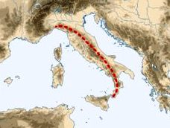
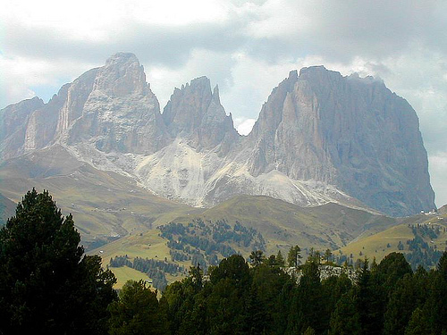
Scenario #7
Intelligence from his spies told Hannibal several things. Winter in this area would restrict his options greatly. Food would be in short supply, and proper quarters would be scarce.
His options were fairly limited. He could push south and try to find a better climate, but that would bring him very close to Rome, and bring even more danger. Or he could cross the Apennines to get to better weather and land on the other side, but with winter full upon him, the crossing would be very difficult, and, geez!, another set of mountains? Still, he had to do something.
What do you suppose he did?
Option 1 Cross the Apennines.
Option 2 Find local shelter for winter.

Slide 22
Option 1: Cross the Apennines
You made the same decision that Hannibal did, and it cost you both. Because of the terrible winter in the Apennines, he lost many men and all but one of his elephants. He ended up having to return to the Po valley and spend his winter there anyway, so it was all nothing. It was an uneasy season, and emotionally taxing on Hannibal and his men. When the spring of 216 BC came 'round, the Carthaginian army was not as powerful as it might have been.
Go to the Next Decision

Slide 23
Option 2: Find local shelter for winter
You have changed History!
This time, you may have even improved it. By choosing to cross the Apennines, Hannibal made one of his few bad decisions. Winter had come so heavily that these mountains were worse to cross than the Alps. He lost all but one of his elephants, and eventually ended up turning back. Had he not gone here, he would have had more men and elephants for the spring assault.
Go to the Correct Answer!

Slide 24
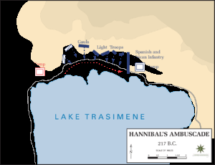
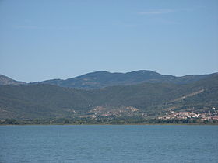
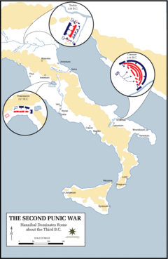
Scenario #8
Having survived the winter, Hannibal moved south to pressure Rome itself.
The Romans had held another election, and the consul now assigned to pursue Hannibal was named Flaminius. Often, in Rome, a high-ranking official might become wealthy and powerful, but feel less of a man if he had not led the army to some glorious victory. Flaminius greatly desired such glory, and so he moved north with his army in eager anticipation.
Hannibal had reached Lake Thrasymene. Here was a narrow pass where the lake comes directly to the foot of the mountain. From his camp on the north side of the pass, Hannibal could clearly see the approaching Roman army. His excitement was heightened by the knowledge that Flaminius would probably jump at the wrong opportunity for attack, and once again leave Hannibal victorious. All he had to do, was make the right decision. Would you?
Option 1 Attack Flaminius now.
Option 2 Wait on Flaminius to come to you.

Slide 25
Option 1: Attack Flaminius now
You have changed History!
And this time, with probably disastrous results. It would be very foolish to try to fight in any way. If you put this narrowness to your back you cannot retreat; if you fight around the pass, you can't use all your forces. The only logical thing to do is to try to entice Flaminius into coming to your side.
Go to the Correct Answer!

Slide 26
Option 2: Wait on Flaminius to come to you
Hannibal hid some men upon the mountainside, and withdrew somewhat from the pass, which Flaminius took as a signal that Hannibal was afraid (silly boy). Hastening to chase Hannibal down and pound on him, Flaminius ran directly into the trap. Hannibal knew that, once through the pass, no army could retreat, and that worked perfectly for him. Flaminius' determination and impulsiveness cost him his army, and his life
Hannibal, as always, had decisions of his own.
Here is the next one.

Slide 27
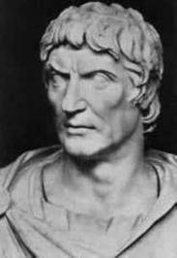
Scenario #9
With this defeat, the Romans resorted to their final option: they decided to appoint a dictator. The dictator had supreme power over every operation of the military and government, to ensure the best possibility of success. Though the dictator's term was limited to 6 months.
The Romans could scarcely have chosen a better man for the job than Fabius. He was, by all accounts, a level-headed person, with no desire to be a god or lifetime ruler. He began by ordering all the residents of small northern towns to evacuate, and to burn all the buildings they owned, as well as any food they could not take with them to the larger, fortified towns. This would leave Hannibal with few resources, and force him to move more frequently, in search of supplies.
Fabius then originated the style of fighting that is now named for him. The Roman army delayed all conflict as long as possible. As if in a great Chess match, the two armies circled and danced with each other, with the Roman force always remaining just out of range of Hannibal's jabs. These "Fabian tactics" caused Hannibal to struggle for food, while remaining constantly on the defensive. Fabius was certain that, eventually, he would maneuver Hannibal into a bad position.
Fabius' strategy eventually paid off, when Hannibal surrounded by high hills on all sides, wandered through a narrow pass unknowingly, and found himself trapped
Still, Hannibal must do something in this situation, or he would be doomed. He could try to fight his way through the narrow pass, or try to go up one of the hills, and thus out of the box. If he chose incorrectly, Fabius would annihilate him, and the war would be over. Which choice would you make?
Option 1 Charge up the Hill.
Option 2 Escape Through the Pass.

Slide 28
Option 1: Charge up the Hill
You have changed History!
The Romans were sure it would be foolhardy for Hannibal to attack uphill, but he did have a way of pulling off actions lesser Generals could not. This, however, would have been a very difficult one to accomplish. He did use the hills in his strategy, though.
Go to the Correct Answer!

Slide 29
Option 2: Escape Through the Pass.
As usual, Hannibal could not do anything without a touch of trickery. In the dark of night, Hannibal tied torches to the horns of oxen he had in camp. When his troops were ready to move, the torches were set on fire, and the oxen were sent off up the hill.
At first, the Roman troops worried that the Carthaginians were escaping and prepared to go reinforce their defenses on the hilltops. As the torches burned, the oxen brushed against trees and shrubs, setting them afire as well.
Finally, the torches began to burn the horns of the oxen, who ran about wildly. The Romans mistook this as an attempt by the Carthaginians to assault them from above, and the Romans prepared to respond. Pulling troops away from the pass, they eventually found themselves fighting forest fires and oxen.
While they did so, Hannibal sneaked his army out through the pass, and off to safety. Amazing, isn't it?
This presented him with new opportunities and choices.

Slide 30
Scenario #10
After Hannibal's escape, Hannibal found that his food supply had become impossibly low. He desperately needed supplies, and had to go in search of new sources.
The Roman consuls were now Aemilius and Varro, who added to the leadership problem that had plagued Rome from the beginning. Aemilius was a friend of Fabius, who thought it wise to continue the Fabian tactics. Varro was another impulsive soul, who could not wait to demonstrate his skill against the Carthaginian General.
The Battle at Cannae was one of the most horrific battles in history. Some 50,000 Carthaginians faced about 80,000 Romans, and the killing was vicious on both sides. Hannibal once again used a trick, having a large segment of his army pretend to quit become “prisoners” of the Romans. Because of the bloodiness of the battle, the Romans could not spare many men to guard the Carthaginians, and, at the right moment, the "prisoners" attacked the Roman army from behind. Many Romans were slaughtered, including the consul Aemilius. Despair plagued the Romans, who now believed that all was lost.
Hannibal was now faced with his greatest decision. Rome lay before him, with no army to protect it. To lay siege to a city so large, with high walls and an immense population, would take a very long time, and it appeared to Hannibal that the citizens would fight him with rocks and sticks if necessary. It was nearly winter again, and Hannibal knew it would be difficult to besiege a city in poor weather, when his troops would have to live in the open. At the gates of his ultimate obstacle, Hannibal faced the ultimate decision. What would you do?
Option 1 Attack Rome Now
Option 2 Wait for Spring &/or Reinforcements from Carthage

Slide 31
Option 1: Attack Rome Now
You have changed History!
Had Hannibal chosen to lay siege to Rome, all of Western history would have changed. There is no guarantee that he would have been successful, because it is certain that the Roman citizens would have fought tooth & nail through the streets. Rome was still in the flower of its Republic, and the people would not likely have taken well to being ruled by an "outsider". If he had been successful, Rome would likely have been looted of all its treasure, and perhaps burned to the ground. Carthage would have ruled the entire western Mediterranean region with virtually no opposition.
Go to the Correct Answer!

Slide 32
Option 2: Wait for Spring &/or Reinforcements from Carthage
By choosing to withdraw, Hannibal lost his only chance to defeat his hated Romans. He sent to Carthage great baskets of rings taken from the hands of the Roman soldiers killed at Cannae. Then requested money and reinforcements in the same message. They debated for a long time, before granting his wishes, and the delay ruined the assault.
Go to the next decision!

Slide 33
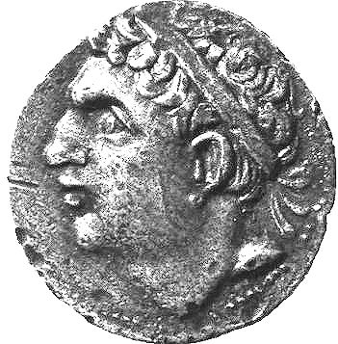
Scenario #11
Hannibal's men, lost the edge that had made them so successful in the past. For 9 years, they were in a stalemate, for when Hannibal would attack Rome, the Romans would attack Capua.
Carthage decided to sent Hannibal's reinforcements by the same path Hannibal himself had taken. This force was led by Hannibal's brother, Asdrubal. For this decision, you get to see the situation from Asdrubal's point of view.
Asdrubal was excited to join his famous brother, and help him complete his mission. Asdrubal knew that Hannibal had been a in a strange land for many years, and would welcome the assistance from home that he had craved. Descending from the Alps, Asdrubal could barely contain his enthusiasm for battle. He was now faced with a decision of his own.
Should he send word to his brother that he had arrived? The news would surely be appreciated, and would help Hannibal maneuver into position to link the two armies. Asdrubal could also keep pressing forward, until he encountered Hannibal, but Asdrubal was unfamiliar with the territory, and was not certain of the best path. What would you do?
Option 1 Send word to Hannibal
Option 2 Proceed with your Army

Slide 34
Option 1: Send word to Hannibal
Because there were spies everywhere, Asdrubal's messengers were captured, and their plans became known. Asdrubal had sent his brother explicit description of his plans, and the Romans used this to their advantage.
According to legend, Asdrubal, realizing that the battle was lost, threw himself into the middle of the fight, where he was eventually killed. The Romans cut off Asdrubal's head, and threw it into Hannibal's camp as a message that all was lost to the Carthaginians. With no further hope for help from home, it seemed that the situation could not get worse for Hannibal
Go to the your Next Decision!

Slide 35
Option 2: Proceed with your army
You have changed History!
There is no way to prove it, but it seems very likely that Asdrubal might have defeated the Roman army in the north, while Hannibal fought the Romans in the south. Together, they may have totally destroyed Roman resistance, and finally, conquered Rome itself. Asdrubal was foolish, however, and underestimated the effect of the spies we have discussed so many times before.
Go to the Correct Answer!

Slide 36
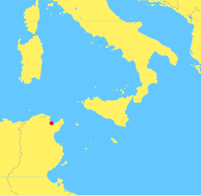
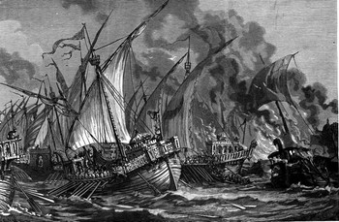
Scenario #12
While the death of Asdrubal was a tremendous emotional loss for Hannibal, his biggest concern as a commander was coming from other places. Word had been received that Carthage itself was now under attack.
Scipio Africanus Major, son of the Scipio we previously met, had taken a force to North Africa, with the intention of removing Hannibal from Italy by forcing him to come home to defend his own city.
The Senate asked Hannibal to return home to defend them. He had Rome in front of him, and the possibility of his own siege to consider in the process. He could take Rome, but also lose Carthage in the process. On the other hand, if Hannibal took Rome, Scipio might be forced to surrender, having no city to support him. What did he do?
Option 1 Attack Rome
Option 2 Return Home

Slide 37
Option 1: Attack Rome
You have changed History!
Even though it makes an interesting scenario, it would have been worthless to Hannibal to rule Rome while Scipio destroyed Carthage. If it became a race, Carthage would probably have fallen first, since the Romans had made many allies in North Africa, and could use their help to cut off Carthage from its surroundings. Italians had grown weary of Hannibal and his army trampling the countryside, and were not likely to help him in any way. The only logical thing he could do, as a loyal Carthaginian, was to return home and defend his people.
Go to the Correct Answer!

Slide 38
Option 2: Return Home
With an army that had grown relaxed, and an enormous city in his way, Hannibal's only real choice was to return home. Hannibal felt that fortune had deserted him, and all his years of fighting had gone to waste.
His next decision will be your final choice.

Slide 39
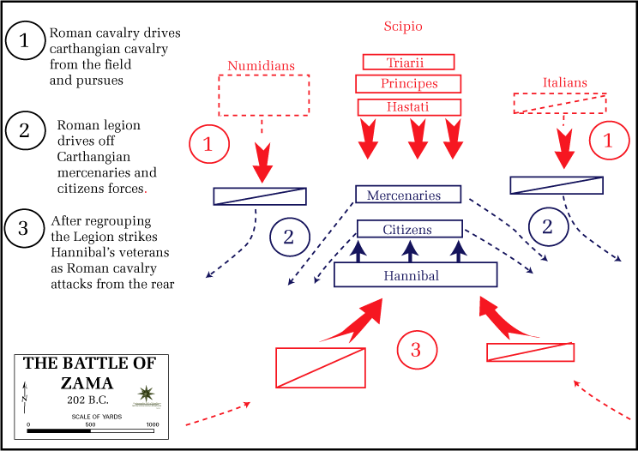
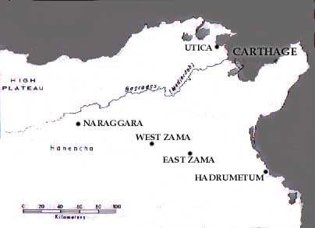
Scenario #13
Outside Carthage lay the Plain of Zama, where the Roman army held its camp. It was now 201 BC, and the Second Punic War had been in effect for nearly a generation. Hannibal went into the camp of Scipio to discuss the terms of engagement. Each appeared to have great respect for the other.
Negotiations were opened, and each gave his terms. Hannibal proposed that the Romans withdraw their army, and the Carthaginians would, in return, avoid any further attacks on Rome or Italy, allow free trade in the Mediterranean, and pay a great fine. Scipio claimed that this was not enough. He ordered Carthage to become a lesser power, to dissolve their army, and to give Rome nearly all of their wealth.
Hannibal was faced with this decision; he must give Rome what it asked for, or fight them once again. What would you do?
Option 1 Battle Once More
Option 2 Surrender & Concede

Slide 40
Option 1: Battle Once More
By choosing to do battle, Hannibal took the honorable, but destructive, path to destiny. There, on the Plain of Zama, two massive armies clashed. It now seems inevitable that the infinite resources of Rome would eventually wear down those of Carthage, but Hannibal had always seemed capable of overcoming even the most impossible odds. In this case, the number, and the years of wear and tear, overcame his ability. The Carthaginian army seemed to have no greatness left in it, and Hannibal had run out of effective tricks.
Go to the Epilogue

Slide 41
Option 2: Surrender & Concede
You have changed History!
It really isn't in Hannibal's nature to surrender, but under these conditions especially, it could not happen. If he had given in, Carthage would have been reduced to a powerless state, and could not have kept its status, or wealth. The Roman Senate would probably have asked for his death. His only option was to fight it out, and let the battle determine the conditions of surrender. He likely knew that he would lose, since his army, like any team that has played too many games, seemed defeated before the battle began.
Go to the Correct Answer!

Slide 42
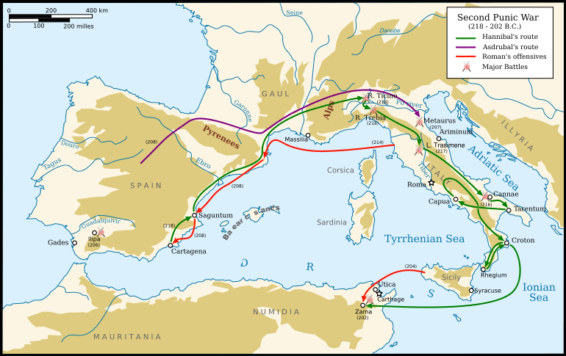

Slide 43
The End of the 2nd Punic War!
Soon, it became obvious that the Romans had won. Hannibal went to the Carthaginian Senate and said, "The fortune which once attended me is lost forever, and nothing is left to us but to make peace with our enemies on any terms that they may think fit to impose."
The Romans required Carthage to give up all foreign possessions, and give its navy to Rome, with the exception of 10 small ships. This was an extreme hardship for a empire based on profit by trade. All war elephants were given to the Romans, and the Carthaginians were forbidden from training more. They were not allowed to take their army outside Africa, and they could not declare war on enemies within Africa unless they had first obtained permission from Rome. (It was this provision that eventually caused the Third Punic War.) They also had to pay Rome a large sum of money for the next 50 years.
Perhaps the most difficult part of the exchange was the decision by Scipio to burn the Carthaginian ships in their own harbor. By the treaty, Scipio had acquired 500 ships, but he did not have enough sailors to man those ships, so he chose to burn them instead. He sailed home in his own vessels, feeling proud of his successes, and leaving behind many angered victims.
The Second Punic Wars were over.

